Slide 1



.
CS 380 - Introduction to Software Engineering
Dr. Adriano Cavalcanti
PhD MABE, MS EE, BSc CSc
Computational Nanotechnology & Biomed Robotics
Office location: Hebeler 107 - Phone 509-963-2063
Email: adriano.cavalcanti@cwu.edu
Office hours:
Mon Tue Wed 11:00am-12:00pm; Or by appointment

Slide 2





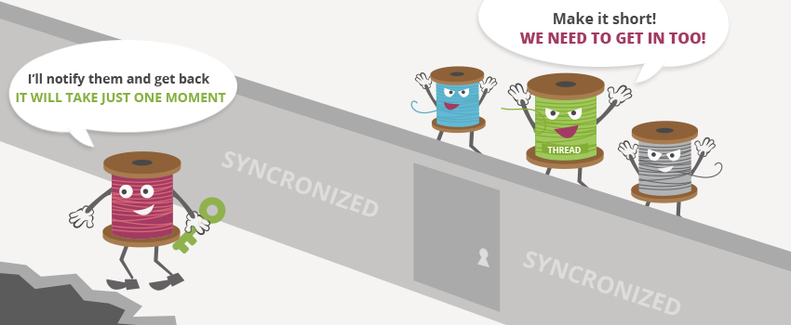
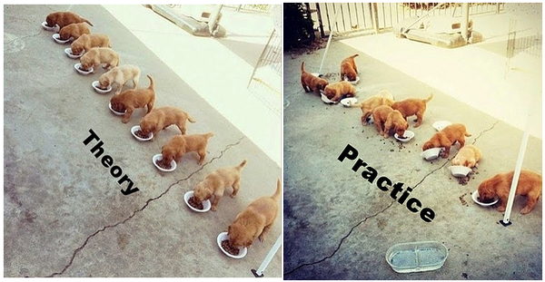


Slide 3


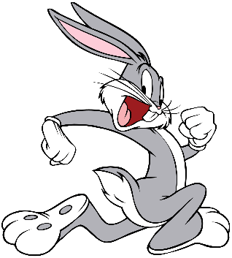


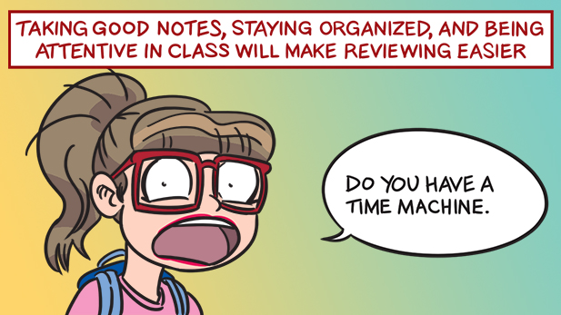
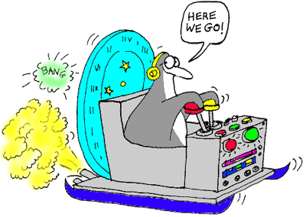
Design Pattern

Slide 4

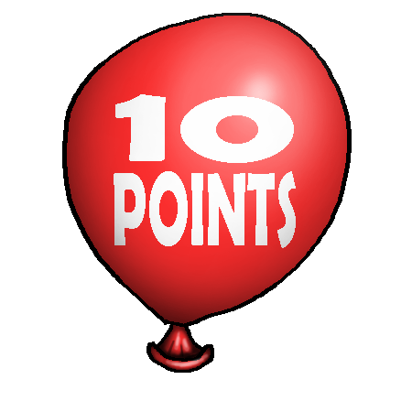



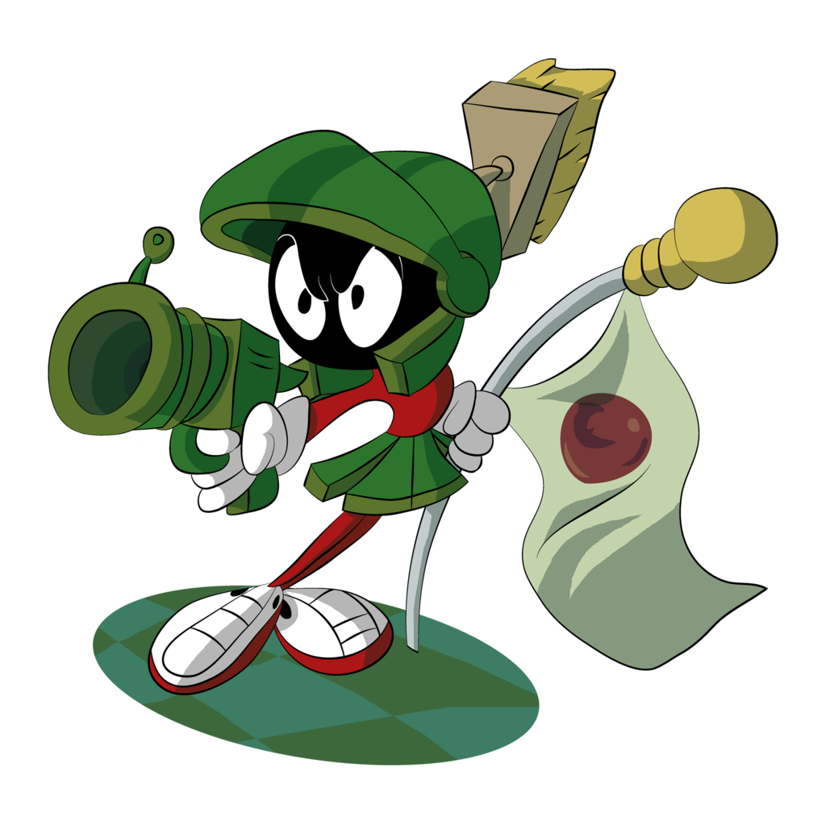

Design Pattern
Team of Two Students

Slide 5
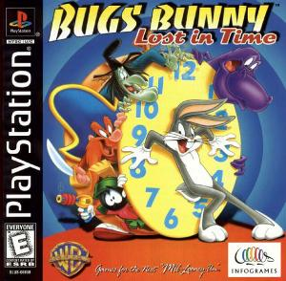


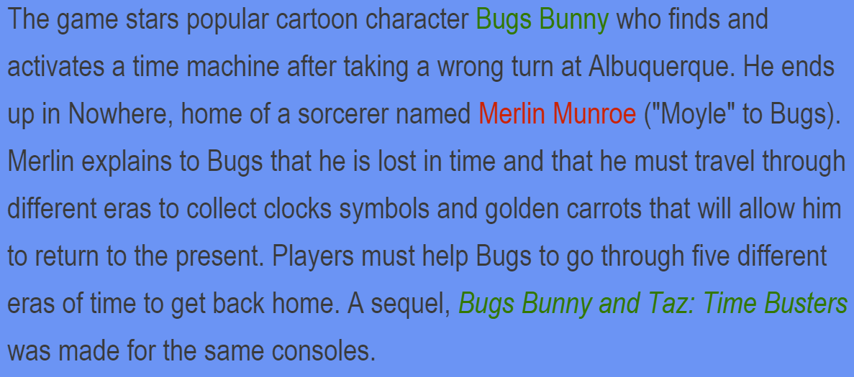



Design Pattern
Ref. http://looneytunes.wikia.com/wiki/Bugs_Bunny:_Lost_in_Time

Slide 6


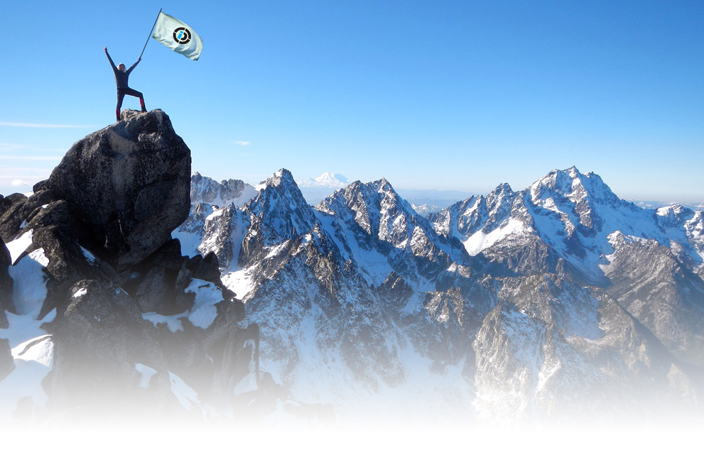
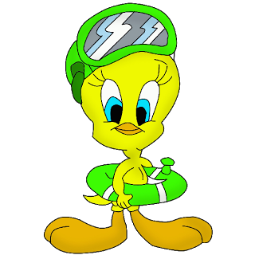


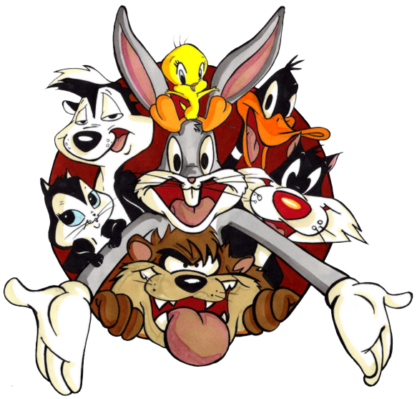
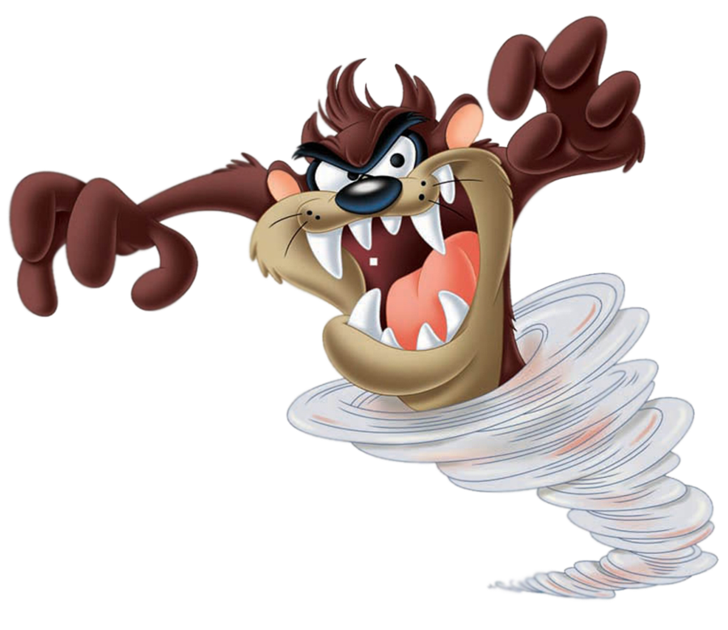

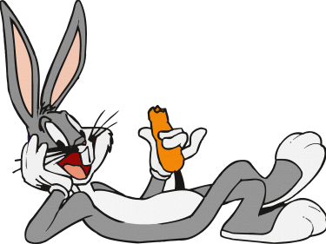
THREAD SYNCHRONIZATION
TIME MACHINE

Slide 7
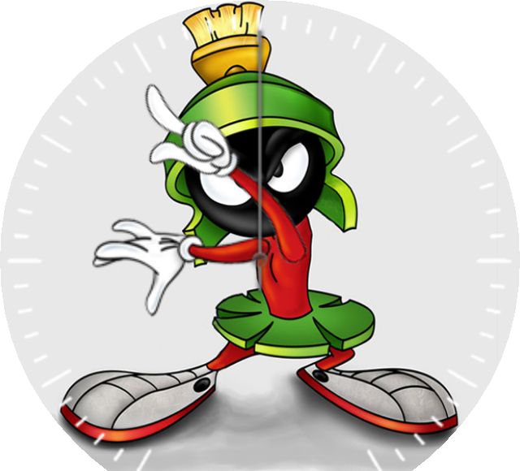
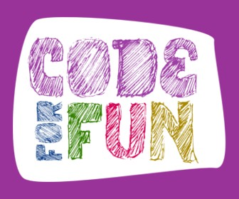

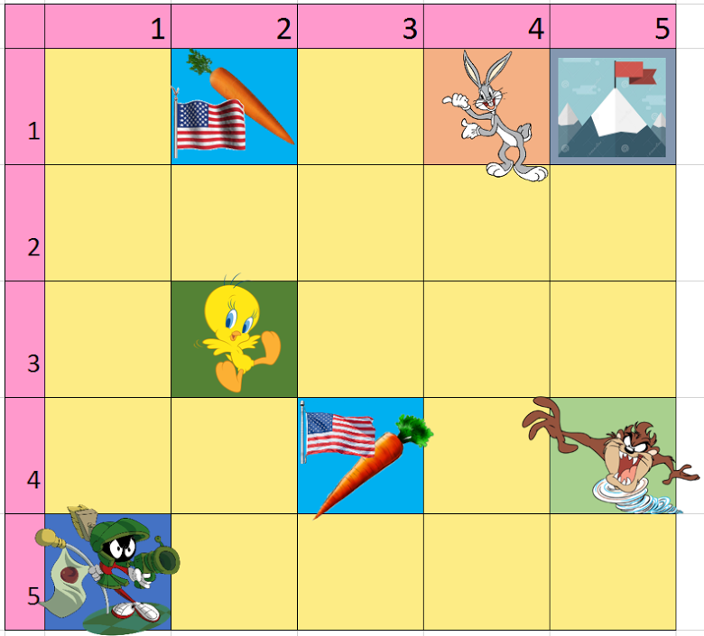
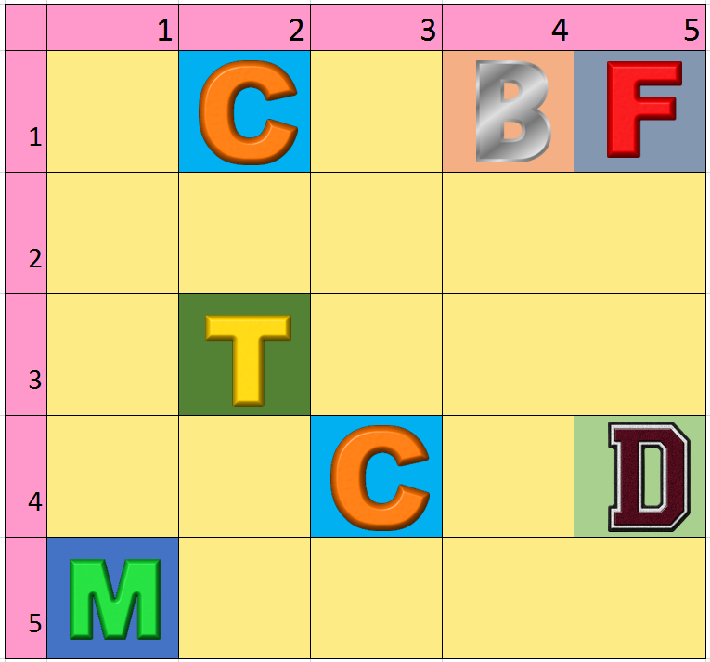

Slide 8







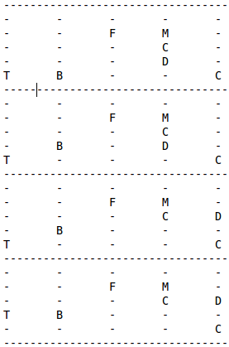
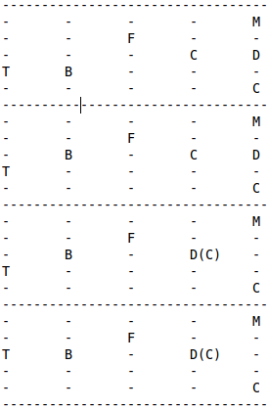
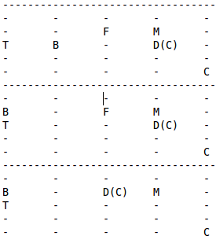
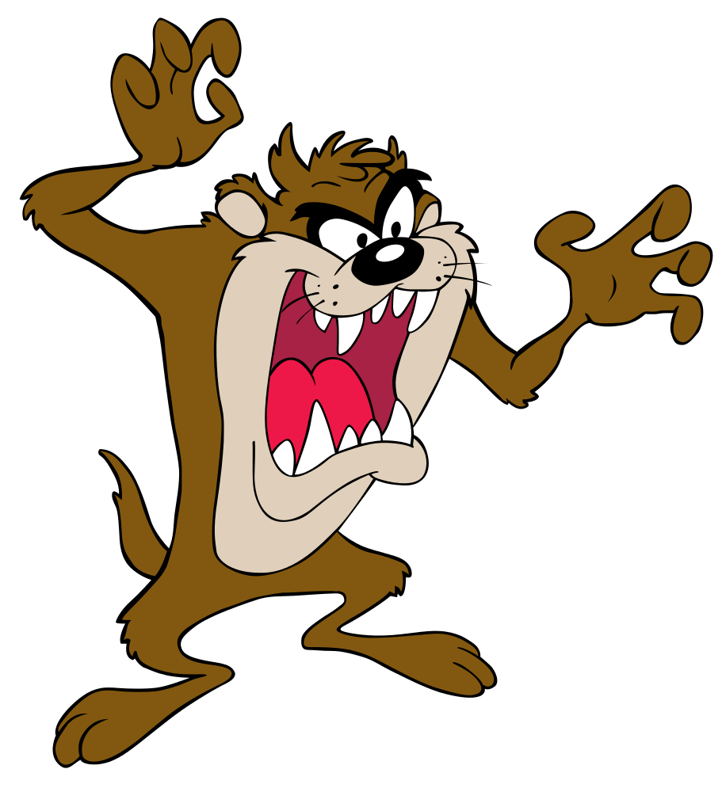

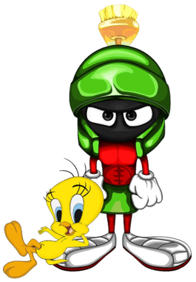

Notes:
8

Slide 9


Create a program with the features:
a) Create four threads that sequentially and respectively represents: Bugs Bunny (B), Taz Devil (D), Tweety (T), and Marvin the Martian (M). Don’t allow threads to collide, synchronizing them properly. (2 points)
b) Walking is random motion; The Bunny, Taz, Tweety, and Marvin are trying to win the race in their own thread to take control over the new planet x, accessing the worskspace variables located inside the pthread_mutex_lock only, representing their position in the race; print the board every time a player move his position; the competitor has to locate one golden carrot/flag (C) and then run carrying the carrot/flag (C) to the Mountain (F) top; Whenever someone got the carrot/flag (C), show that he is carrying it printing the toon character with the respective symbol: e.g. B(C) ; Whoever place the carrot/flag (C) first on the top of the Mountain (F) will win the race; in the workspace there are only 2 golden carrot/flag (C), which will allow only two runners to try to get to the top of the Mountain (F) first. (4 points)
c) In the attempt to decrease the chances of others to get to the top of the Mountain (F) first, Marvin activates the space x multi-dimensional time travel machine; every time the machine is activated, the Mountain (F) changes location to a random position as any available/empty square; the time machine is activated every time after 3 complete whole cycle. (2 points)
d) Besides trying to find the carrot/flag (C), Marvin cheats, as he is the only runner that is capable of shooting others to eliminate competitors, stealing a carrot/flag (C). If Marvin steps on the same grid where there is another competitor, Marvin will eliminate the competitor shooting, and stealing the carrot/flag (C) if possible; all other competitors are not allowed to step on the same grid/spot from other competitors; nobody is allowed to step on the spot with the symbol mountain top Mountain (F) if not already carrying the golden carrot/flag (C). The race ends when any competitor place the first carrot/flag (C) on the top of Mountain (F). (2 points)

Slide 10
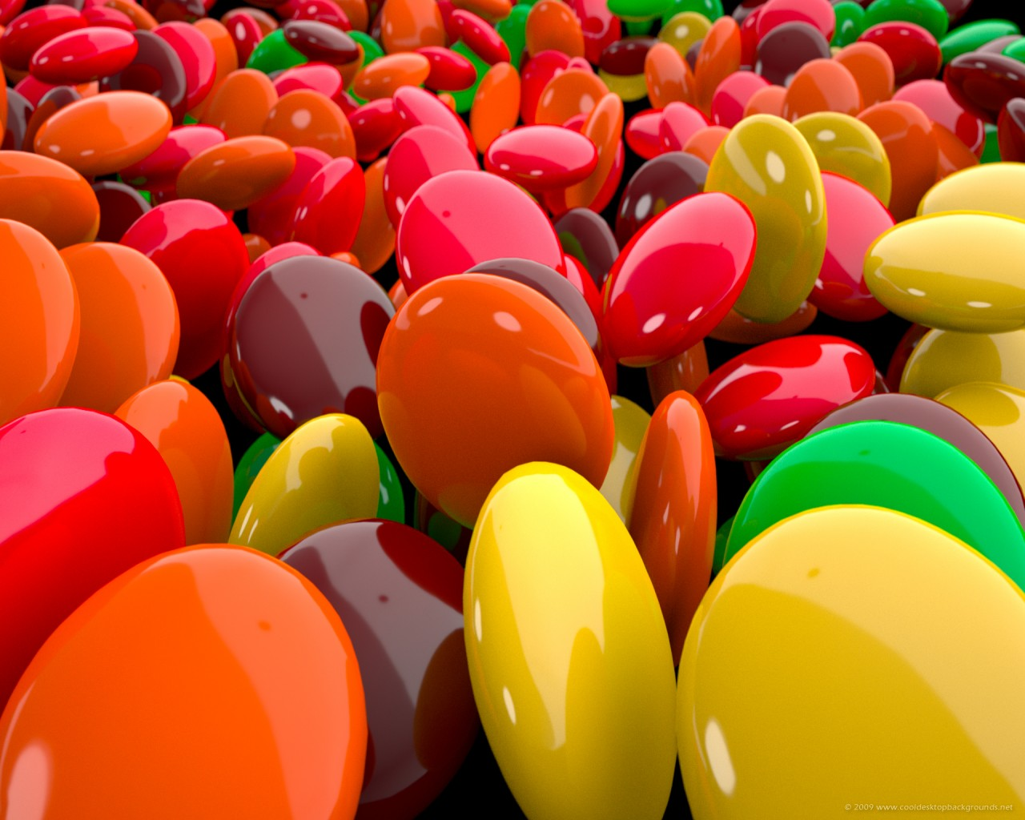

CSE A205 Introduction to C Programming for Engineers
Dr Cavalcanti
Color Candy

